Slide 1


iD Tech Programming
By: Dale Yu

Slide 2

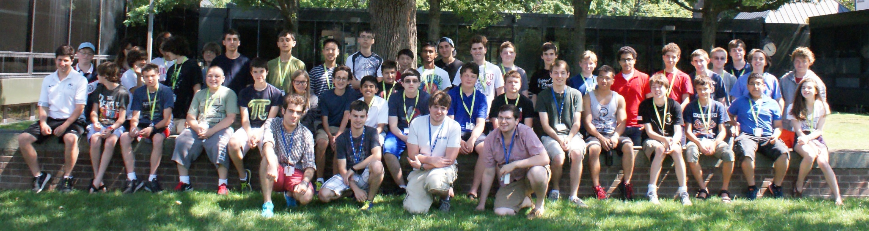
Yale
Web Programming
July 6th to July 18th

Slide 3

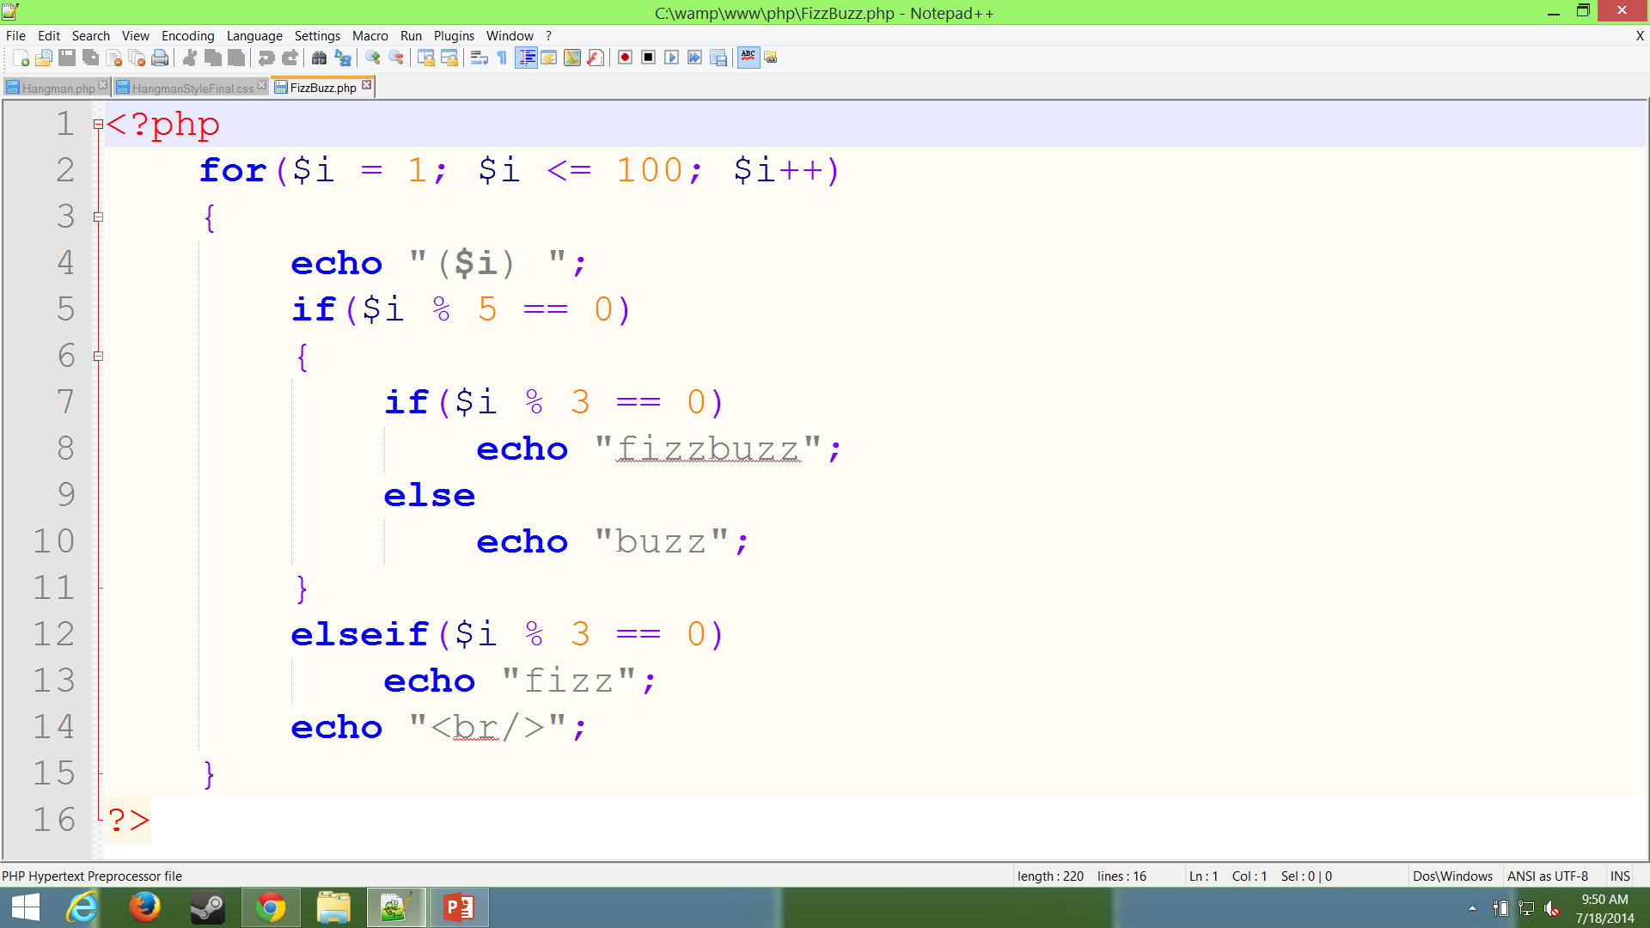
Week 1 – Project
Project Title: Fizz Buzz
Learned how to program php
Made a program to print things depending on the number
Represents how loops and php works
Shows how the % operator and if-else statements work
Replace this image with your own screenshot. Then delete this text.
To replace image: Right click and choose “Change Picture”.

Slide 4
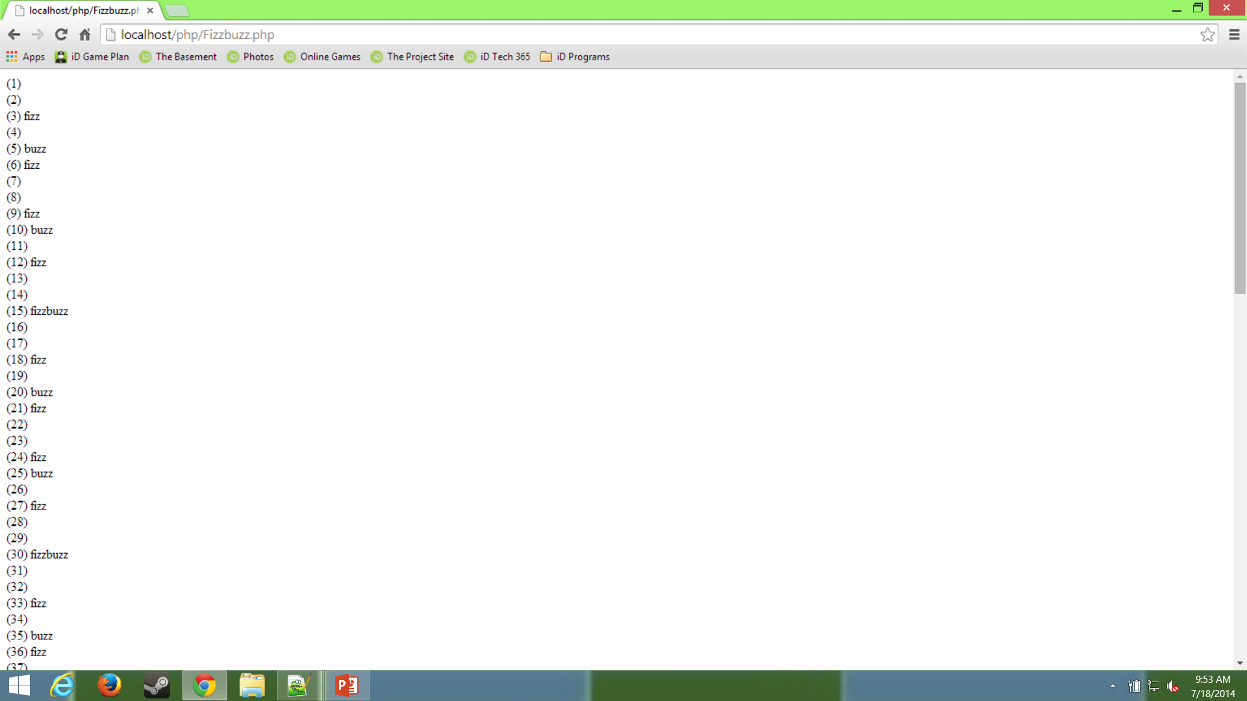
Replace this image with your own screenshot. Then delete this text.
To replace image: Right click and choose “Change Picture”.

Slide 5
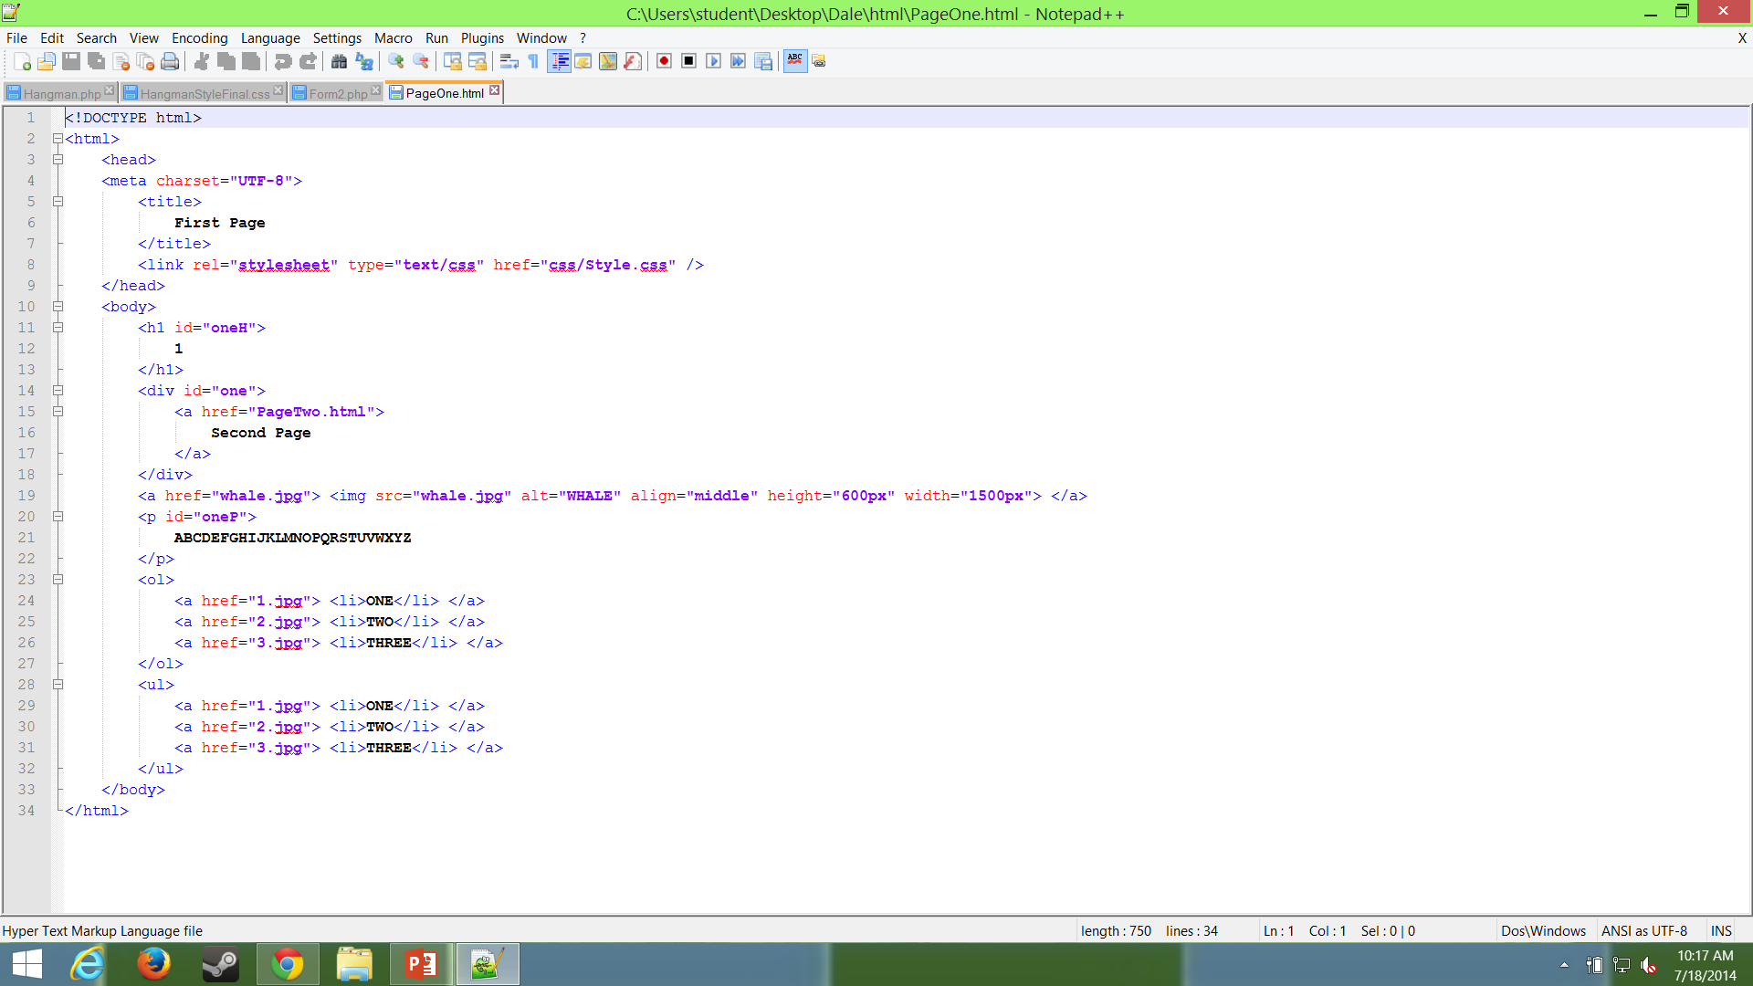
Week 1 – Project
Project Title: Website
Learned how to program website in html
Use of css to style parts of website
Has links and lists
Has pictures and divs
Replace this image with your own screenshot. Then delete this text.
To replace image: Right click and choose “Change Picture”.

Slide 6
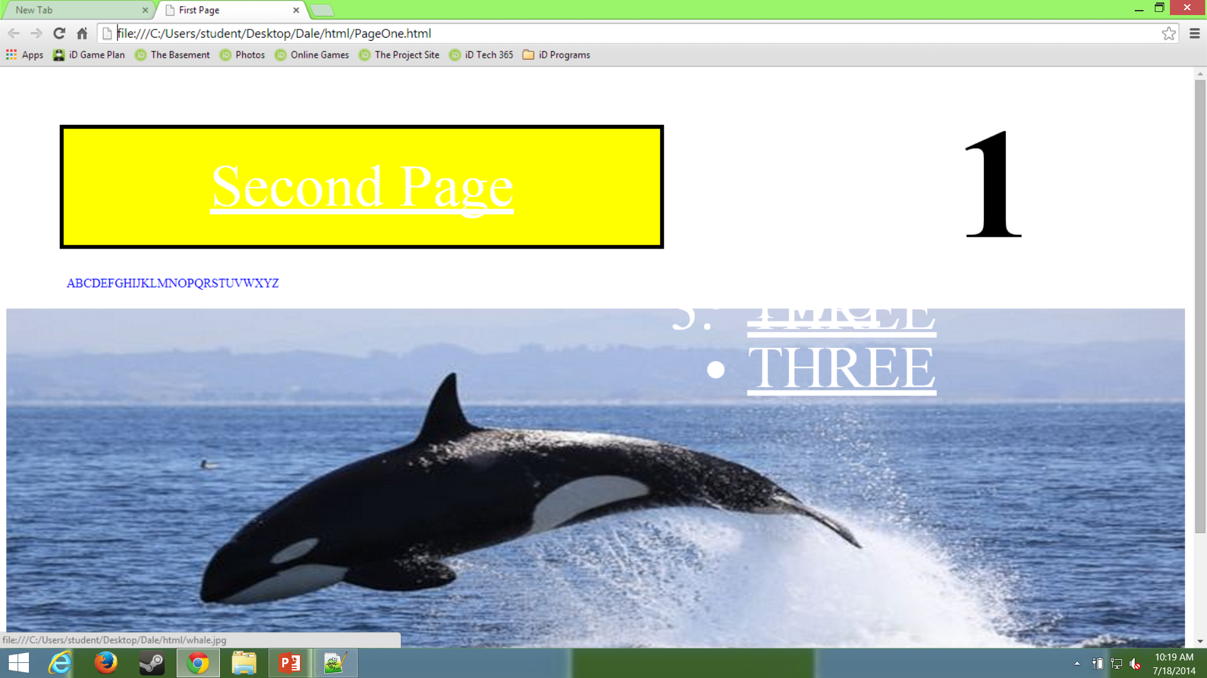
Replace this image with your own screenshot. Then delete this text.
To replace image: Right click and choose “Change Picture”.

Slide 7
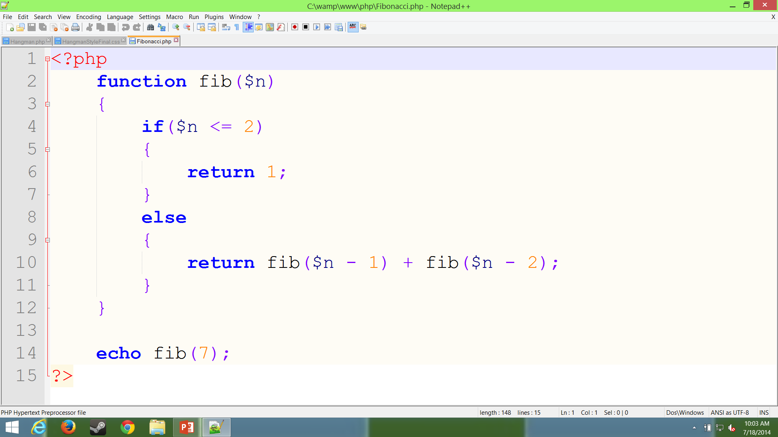
Week 1 – Milestone
Project Title: Fibonacci
Adapting to using php
Learned how it worked
Shows how functions and recursion works

Slide 8
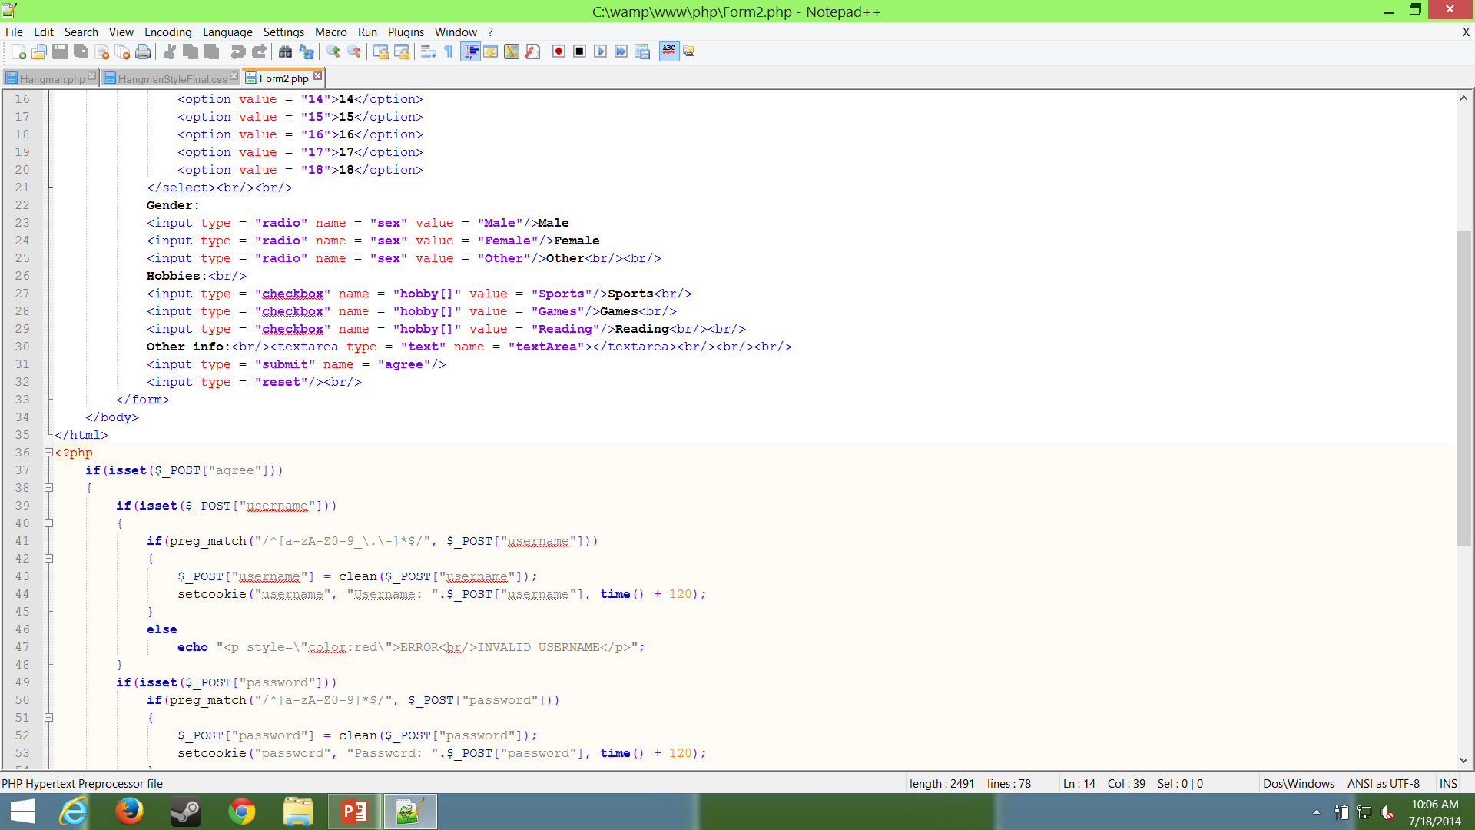
Week 2 – Project
Project Title: Forms
Learned how to make forms
Many different types of input, including buttons or text
Shows how to receive and interpret input
Can also check for proper input
Replace this image with your own screenshot. Then delete this text.
To replace image: Right click and choose “Change Picture”.

Slide 9
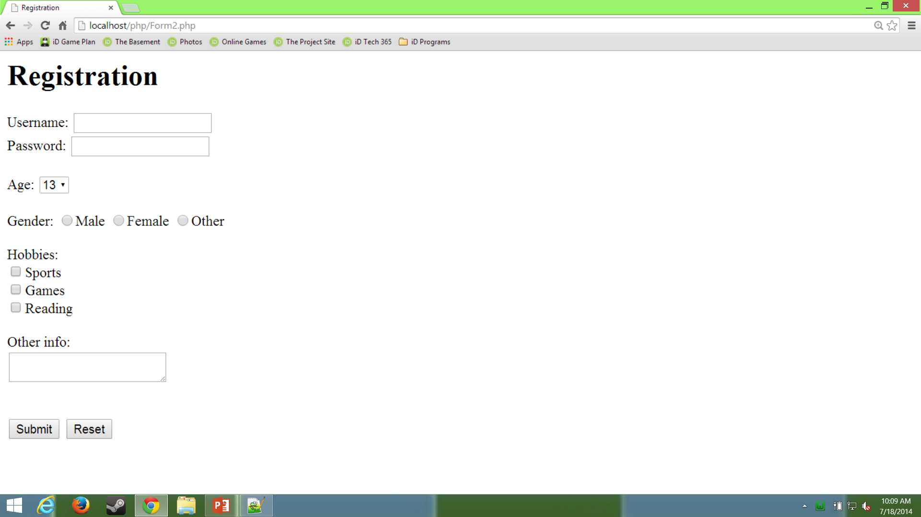
Replace this image with your own screenshot. Then delete this text.
To replace image: Right click and choose “Change Picture”.

Slide 10
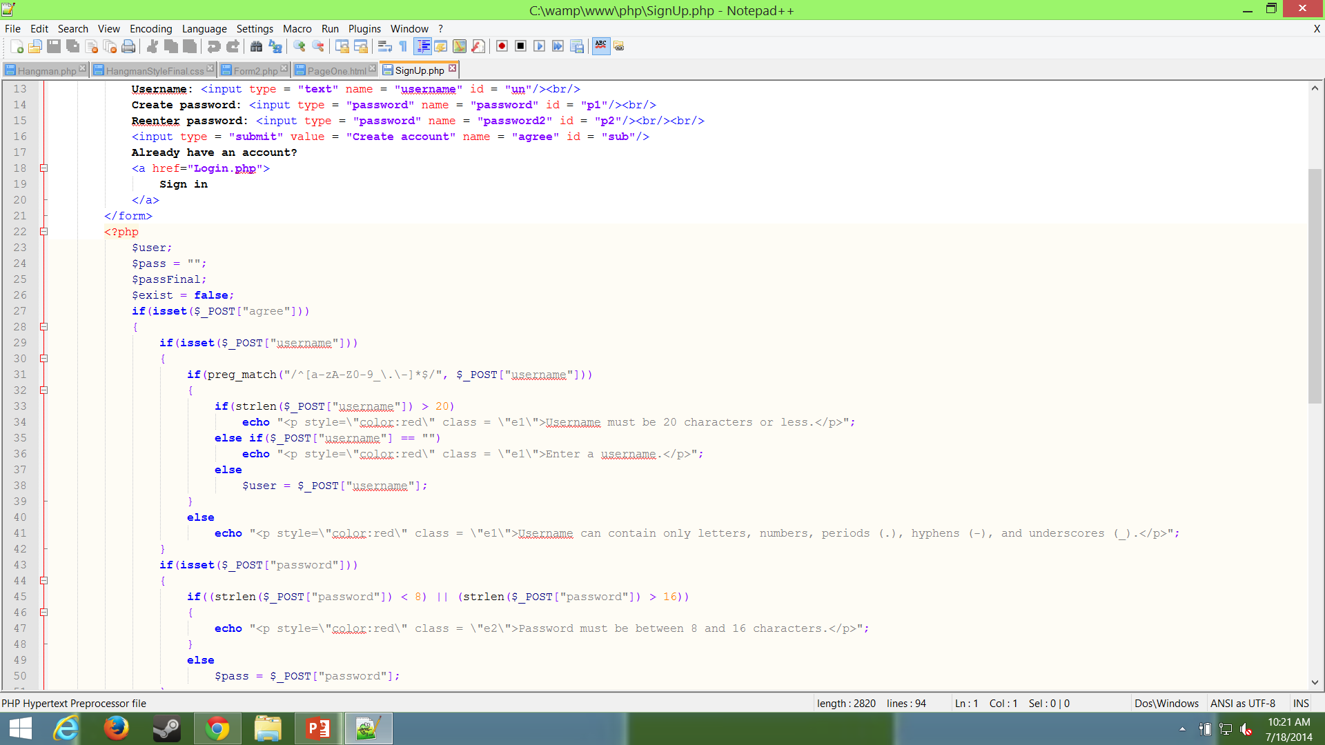
Week 2 – Project
Project Title: Sign-up Page
Used html and php to make a form to sign up
Uses database to store information
Checks for valid input
Uses css to style form to look good
Replace this image with your own screenshot. Then delete this text.
To replace image: Right click and choose “Change Picture”.
Replace this image with your own screenshot. Then delete this text.
To replace image: Right click and choose “Change Picture”.

Slide 11
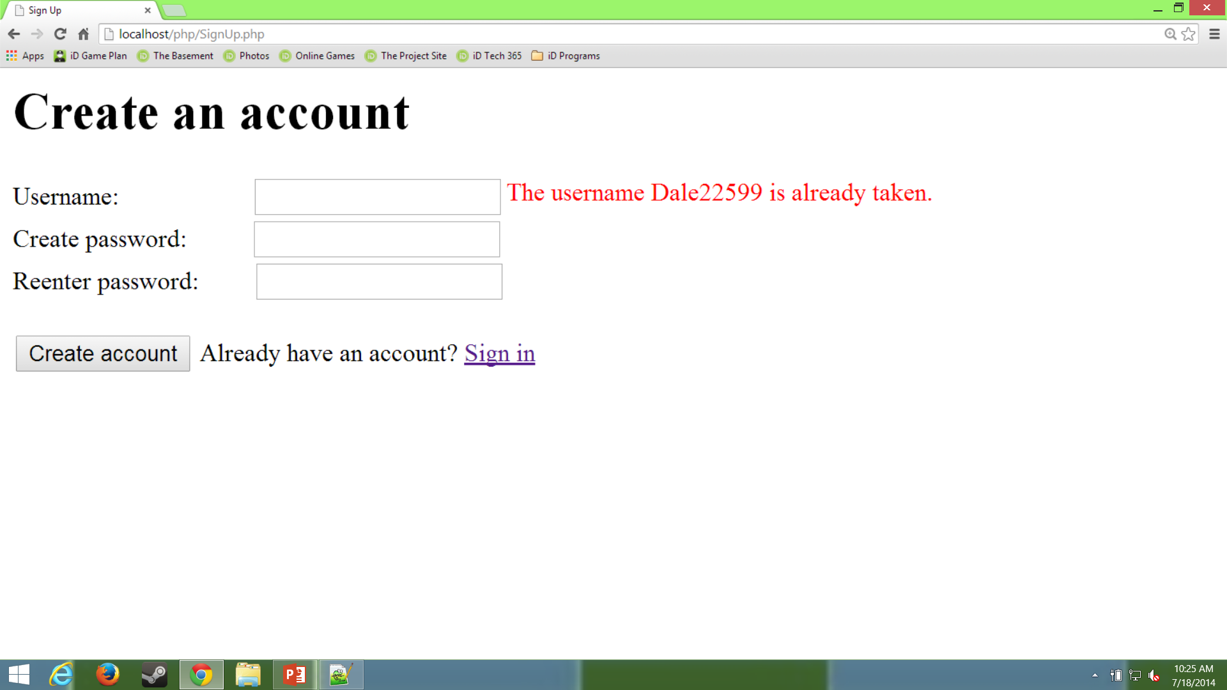
Replace this image with your own screenshot. Then delete this text.
To replace image: Right click and choose “Change Picture”.
Replace this image with your own screenshot. Then delete this text.
To replace image: Right click and choose “Change Picture”.

Slide 12
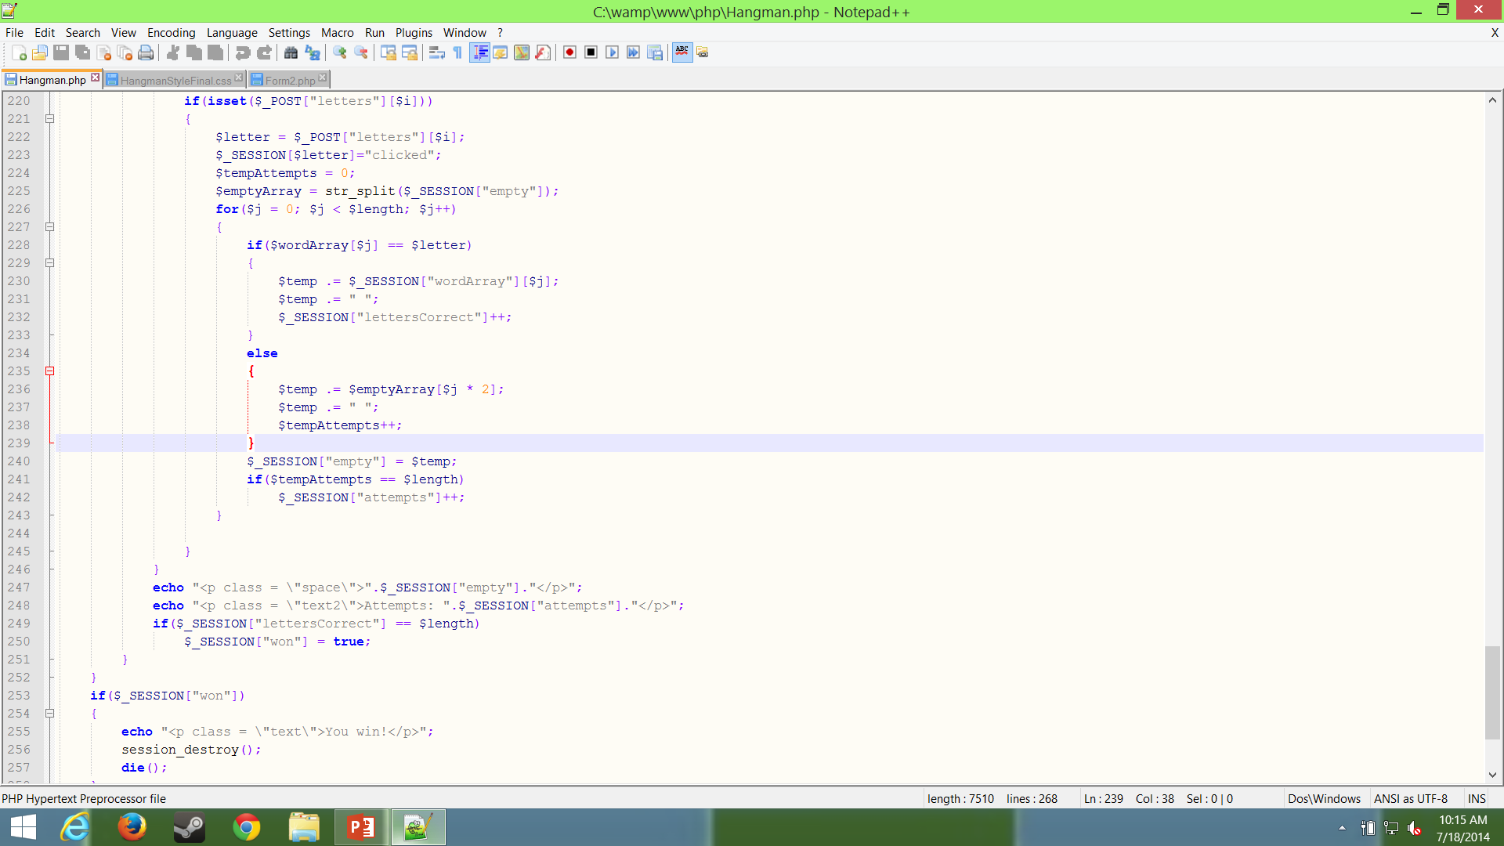
Week 2 – Milestone
Project Title: Hangman
Making things using php
Figured out how to make the programs
Made hangman using html and php
Replace this image with your own screensht. Then delete this text.
To replace image: Right click and choose “Change Picture”.

Slide 13
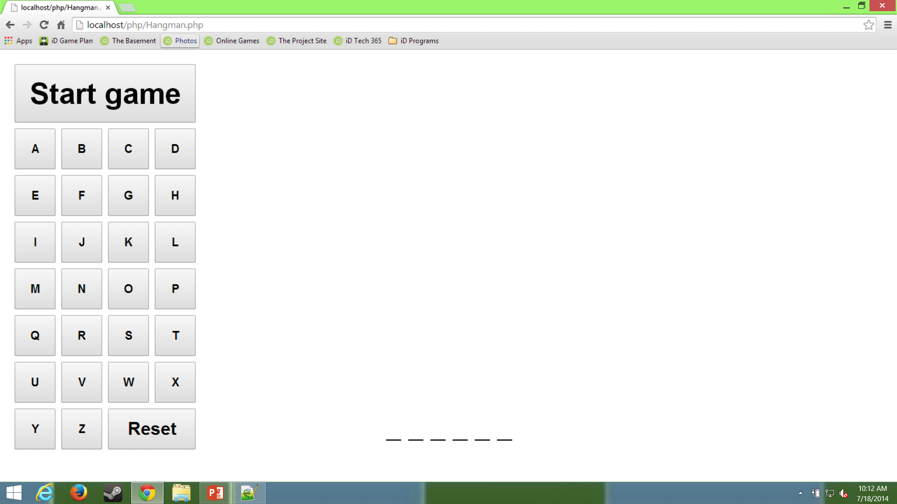
Future Milestones
Would like to try making websites
Enjoy programming things such as games and like challenges
Expect to learn more in depth on how to make a website including javascript and other languages

Slide 14
The End
Thank You for Watching!

